Slide 1
C# Basics..
By ishav

Slide 2
Collections..
Collections in C# are specialized classes that store objects or values in a series.
They are used to modify, store, and organize comparable data more effectively. Collections are fully indexable, meaning that their members can be accessed by passing an integer value in square brackets.

Slide 3
List<T> is a generic class. It supports storing values of a specific type without casting to or from object (which would have incurred boxing/unboxing overhead when T is a value type in the ArrayList case). ArrayList simply stores object references. As a generic collection, List<T> implements the generic IEnumerable<T> interface and can be used easily in LINQ (without requiring any Cast or OfType call).

Slide 4
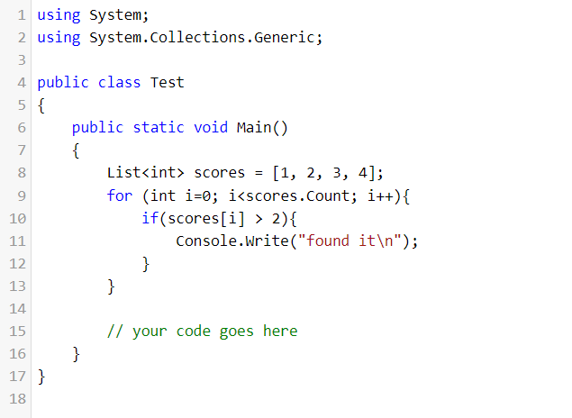
IEnumerable<T> interface & LINQ
IEnumerable<T> interface
Linq helps to query data as simple strings.

Slide 5
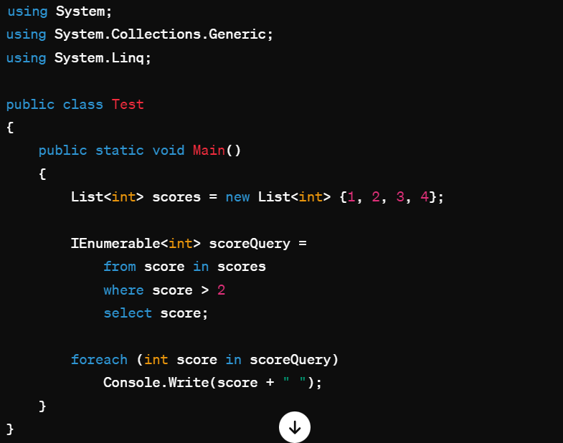
Linq can be used for imperative programming similar to SQL.

Slide 6
System.Collections.Generic
System.Collections (Mainly Used in Older versions – stores object references & need to typecast as well.)
System.Collections.Concurrent
provides various threads-safe collection classes
System.Collections.Specialized(strongly-typed collections; for example, a linked list dictionary, a bit vector, and collections that contain only strings)

Slide 7
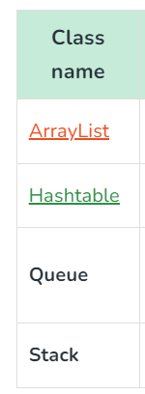
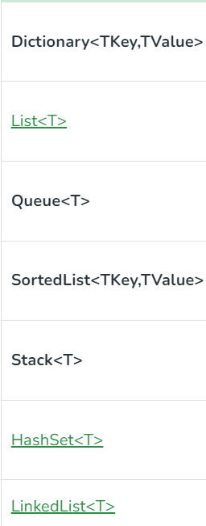
Generic
Non Generic

Slide 8
Compliation in Java
Being OS independent – two step execution model.
1) First through OS independent compiler.
2) In virtual machine (JVM) – custom built for every OS

Slide 9
Principle 1: Compilation
1) source code -> machine – independent encoding (Bytecode)
Step 1: Parse code using AST (abstract syntax trees)
https://www.geeksforgeeks.org/compilation-execution-java-program/

Slide 10
Principle 2: Execution
Need to Add steps here, after understanding

Slide 11
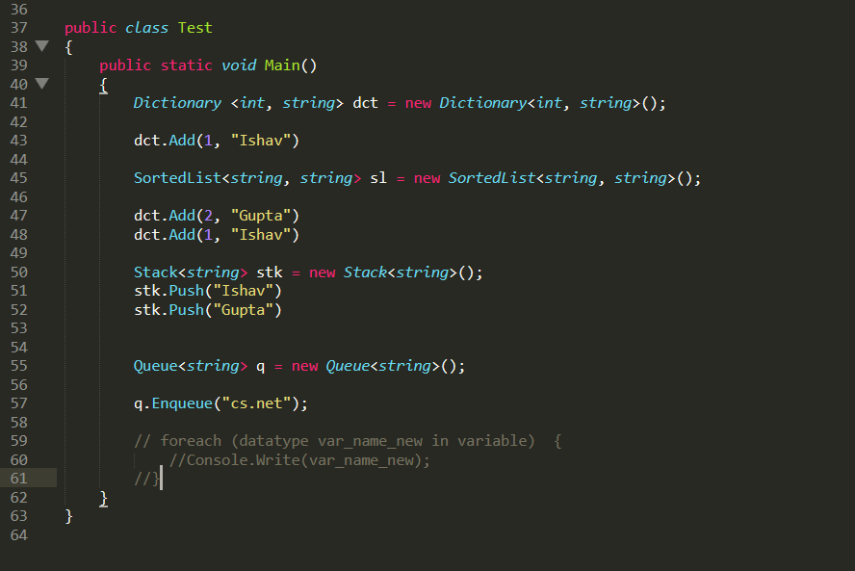

Slide 12
List<int> scores = [1, 2, 3, 4]; -- > VALID DECLARATION

Slide 13
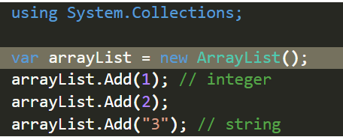
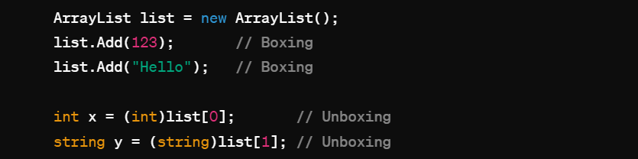
ArrayList
Doubts: var vs ArrayList declaration
Why we always dynamically create a list in csharp.
Does this get stored in heap also like in c++?

Slide 14
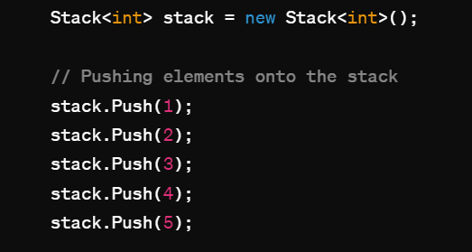
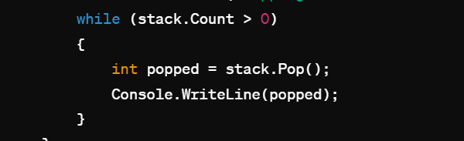
Stack<int>
Nullptr exception-> nothing being alotted

Slide 15
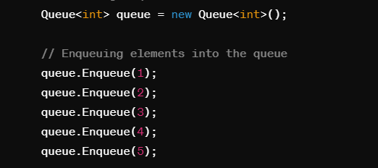
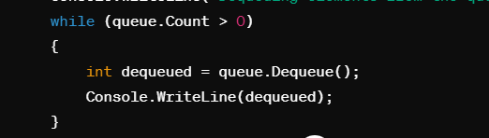
Queue<int>

